Slide 1
Decentralized Model Training with a Tiered Peer-to-Peer Edge Network
CS-6220 : Big Data Systems & Analytics Project
Group 11
Saket Singh Niraj Srimal Raj Kothari Nimish Sule Berkay Barlas

Slide 2
Federated Learning
Machine learning technique that trains an algorithm across multiple edge devices or servers holding local data samples, without exchanging them.
Privacy-sensitive data.
Shared prediction model without sharing of data.
Medical Data, IoT, Siri’s Voice Recognition, Predictive Text, Emotion Recognition.

Slide 3
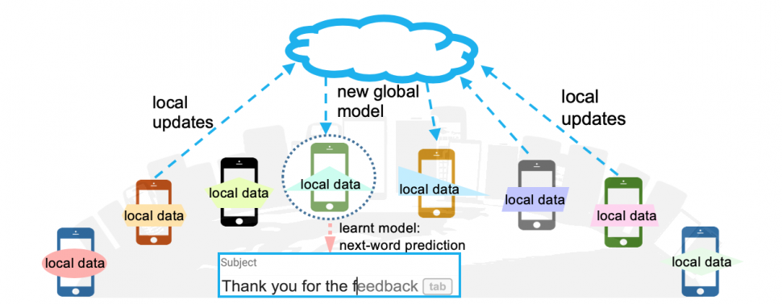
Centralized Federated Learning
Two models : Local and Global.
Local model (Edge Devices) : Trained with local data available at edge devices.
Global model (Central Server) : Local models weights averaging and retraining.

Slide 4
Motivation
Single Point of Failure
Requirement of Central Trust
High Computation Requirements
Less Scalable

Slide 5
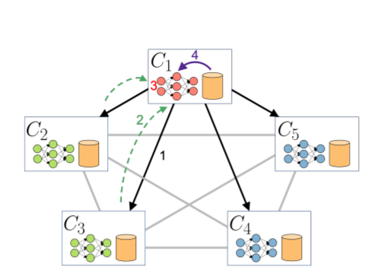
Decentralized Federated Learning
Decentralized Peer-to-Peer Federated Learning.
Eliminates dependance of central sever and central trust.
Fault-tolerant.
Peer-to-Peer.
ML Task - Image Classification.
Design can work for any ML algorithm.

Slide 6
Related Work
Centralized Federated Learning (McMahan et. al), 2016
CIFAR 10 Deep Neural Network Benchmarks
( 2013-)
Decentralized Learning Frameworks
(2020-)
Decentralized Federated Learning (ChainFL, Brain Torrent)(2019-)
Tree Based P2P (Hudzia) (2006)
Tree based P2P for heterogeneous clients
(Zheng, 2012)
Centralized Federated Learning Frameworks (Tensorflow Federated, 2019-)
Heterogeneous devices (Moshfit, 2021-)

Slide 7
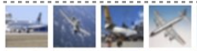
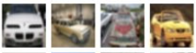
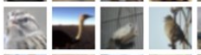
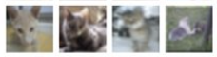
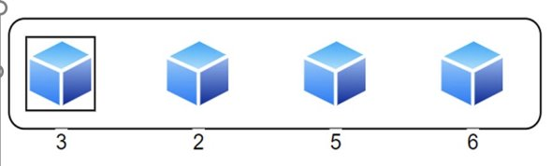
Implementation - Learning
Federated Learning within the Group
Notes:
Detailed Design and Implementation
Every client will has a different

Slide 8
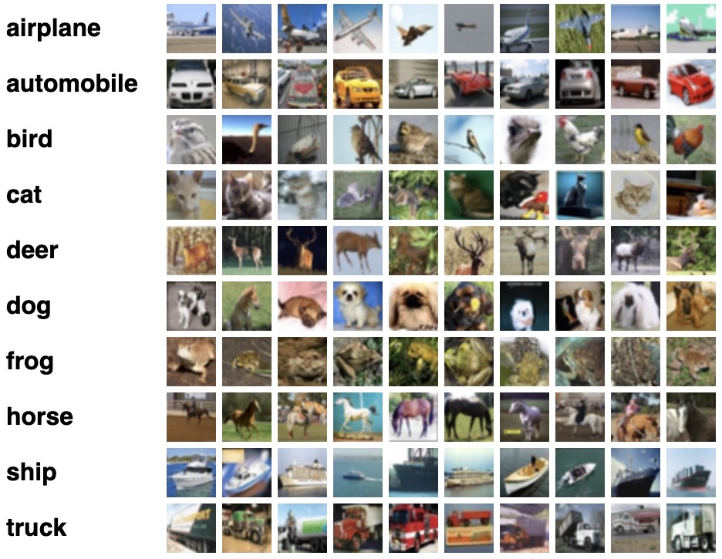
Implementation- Dataset
CIFAR10 / CIFAR100
Why CIFAR ?
Better for Benchmarking
More existing research to compare
Lower compute power requirement for edge devices

Slide 9

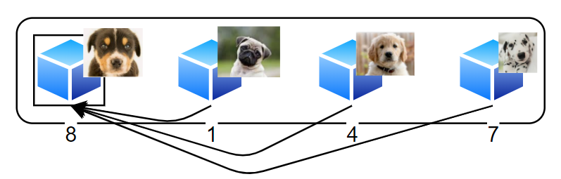
Implementation- Model
Model
32x32x3 input dimension and 12 layers
Keras model Sequential
Linear layer stacks
Standard for Benchmarking
Aggregation
Leader collects weights for each round
Federated Averaging

Slide 10
Why P2P?
Design inherently fault tolerant
Clients join/leave often
Round-wise participants are free to rotate
Minimal central server involvement
Central server can “prepare” clients and get out
Knowledge sharing between a small group of clients
Easy discovery and low configuration costs
Once part of the system, discovery handled by design

Slide 11
Why Tiering?
Limiting client load
Future use case: Cell Phones
Distributed power consumption across devices
Network bandwidth is highly limiting
Highly scalable
Clients’ ease of processing lower amounts of data
Tiers can vertically increase forming large but manageable trees
Slow global convergence, but quick local convergence
Effective geospatial separation
Learning moves with users
Local learning more relevant than global (think going across countries)

Slide 12

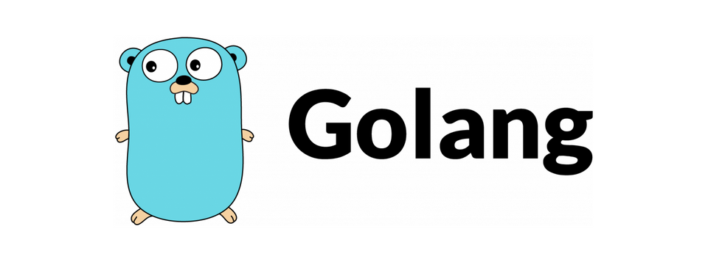

Libp2p - An open-source modular network stack for implementing p2p Framework. Implemented in Go.
Kademlia - Distributed hash table (DHT) communication protocol for decentralized peer-to-peer networks
Python - Application Layer for Federated Learning.
Working over the P2P Framework developed by James Bae – our TA for the course
P2P Design & Implementation​

Slide 13
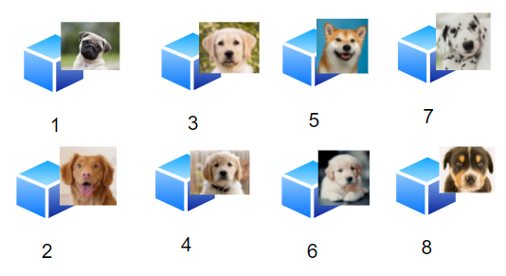
Participating Nodes in the P2P Network
- A Group of nodes participating in the P2P Federated learning

Slide 14
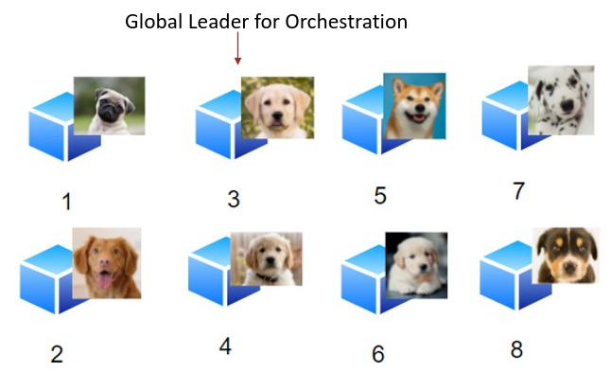
Leader Election in the Distributed Environment
- Global Leader elected among the participating nodes

Slide 15
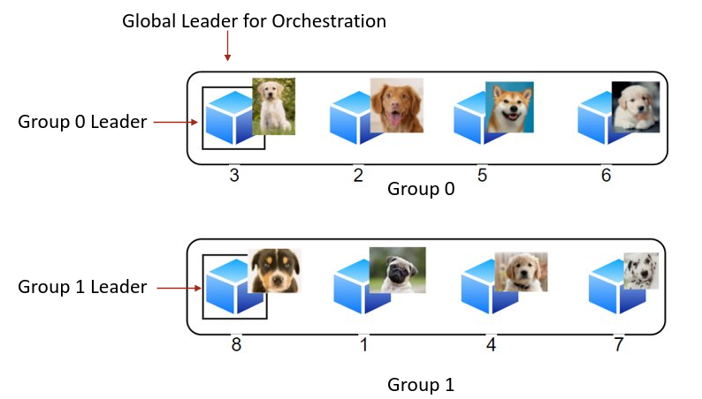
Dynamic Partitioning into Groups
- Global Leader responsible for performing dynamic grouping and electing group leaders.

Slide 16
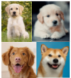
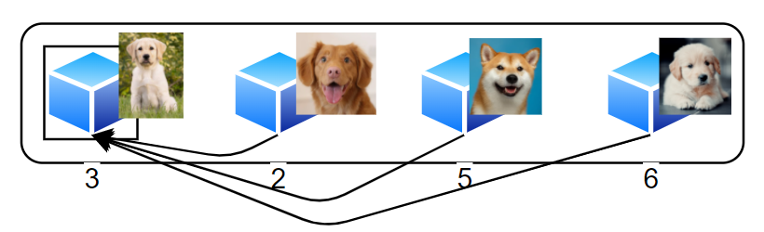
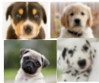
Learning Done at every Group
- Aggregation of Weights into the Group Leader along with Learning.
Global Leader for Orchestration
Group 0 Leader
Group 0
Group 1 Leader
Group 1

Slide 17
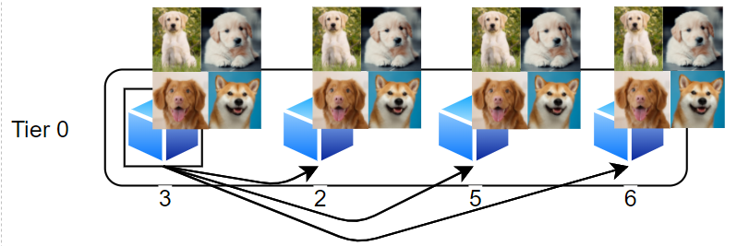
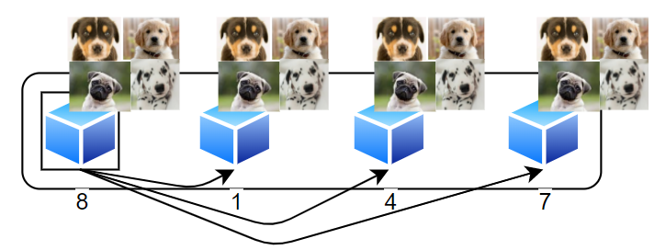
Learning Dispersed across Group Members
- Quick Local Convergence
Group 0 Leader
Group 0
Tier 0
Group 1 Leader
Group 1

Slide 18
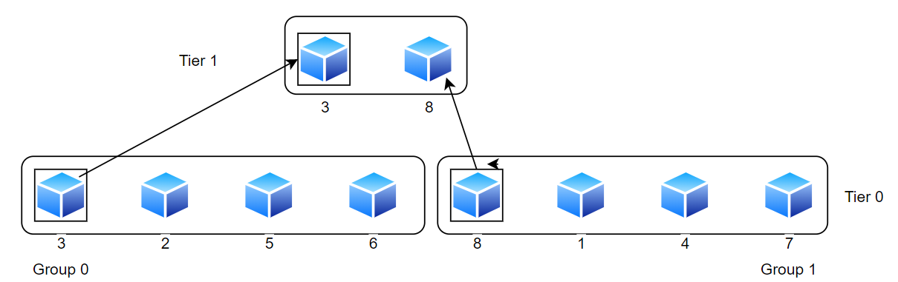
Grouping for the Next Tier
- Nodes from Different Group Participating in the next tier
Group Leader

Slide 19

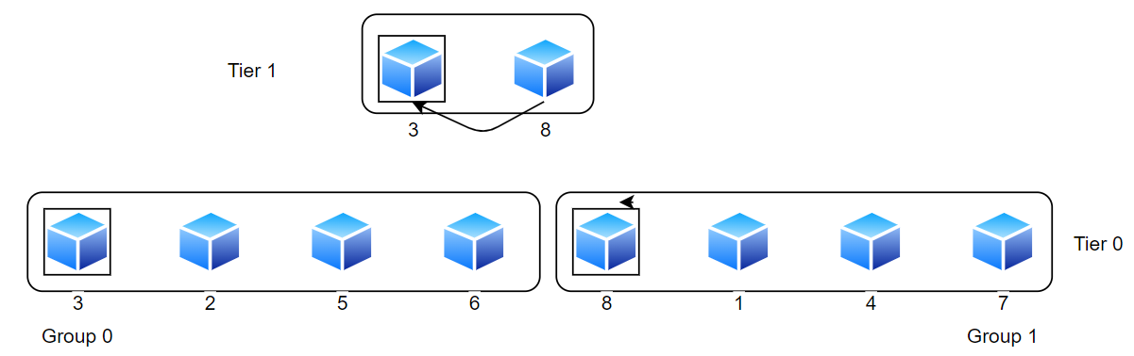
Learning Done at Leader of Group at Tier 1
- Fault Tolerance ?
- Eventual Consistency

Slide 20
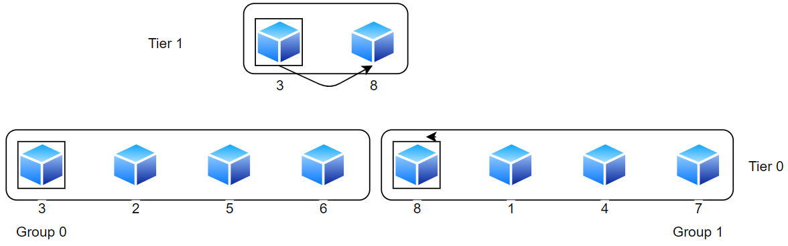
Learning Dispersed across the group at Tier 1

Slide 21
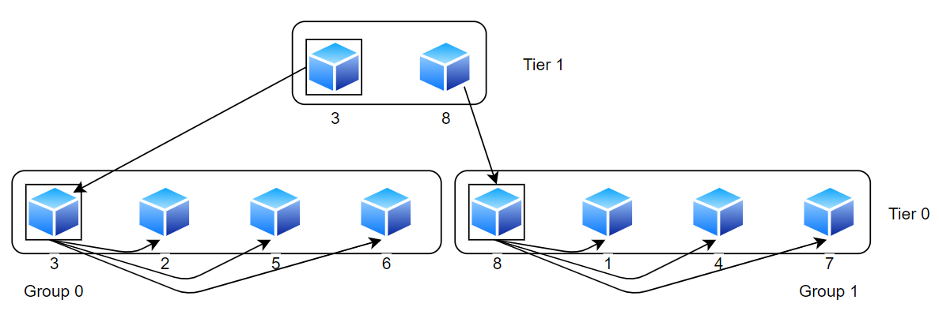
Learning dispersed across the Lower Tiers
- Global Convergence
- Lower Tiers updated with the latest available model for better inference.
Group Leader
Group 0 Leader
Group 1 Leader

Slide 22
Recap

Slide 23
Motivation – Limitations of Centralized Federated Learning
Single Point of Failure
Requirement of Central Trust
High Computation Requirements
Less Scalable

Slide 24
Decentralized Model Training with a Tiered Peer-to-Peer Edge Network
Novel Ideas:
Multi-Tier Hierarchy Architecture.
Eventual Consistency.
Fault Tolerant.
Eliminates dependance of central sever and central trust.
ML Task - Image Classification.
Design can work for any ML algorithm.

Slide 25
Demo

Slide 26
Tree Structure Representation
Use linear arrays and self-indexing to establish tier-based tree topology.
Application-level gossip to distribute tree structure. Addition and removal nodes is notified to all participants
Each peer is aware of all the peers in the network and have a consistent view of the structure – i.e., their positions are statically determined each round.
Some state in peers was ensured using docker-compose – static IP, Node ID, etc.

Slide 27
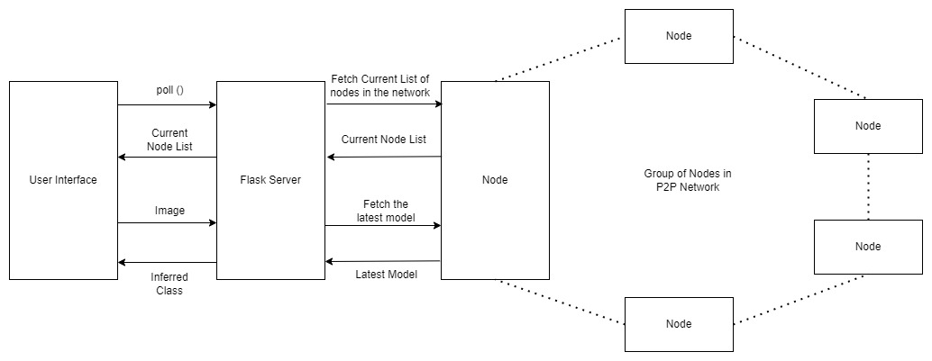
Demo System Architecture

Slide 28
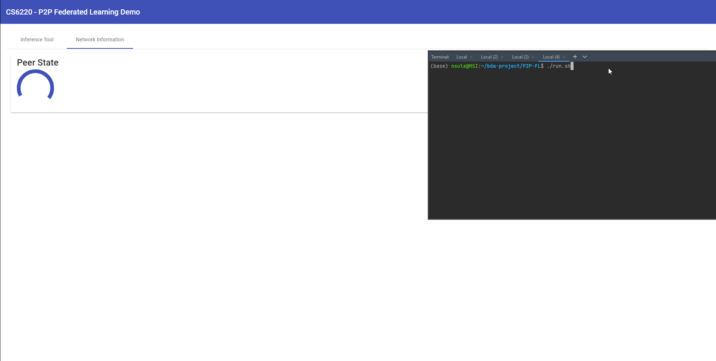
UI – Tree Representation

Slide 29
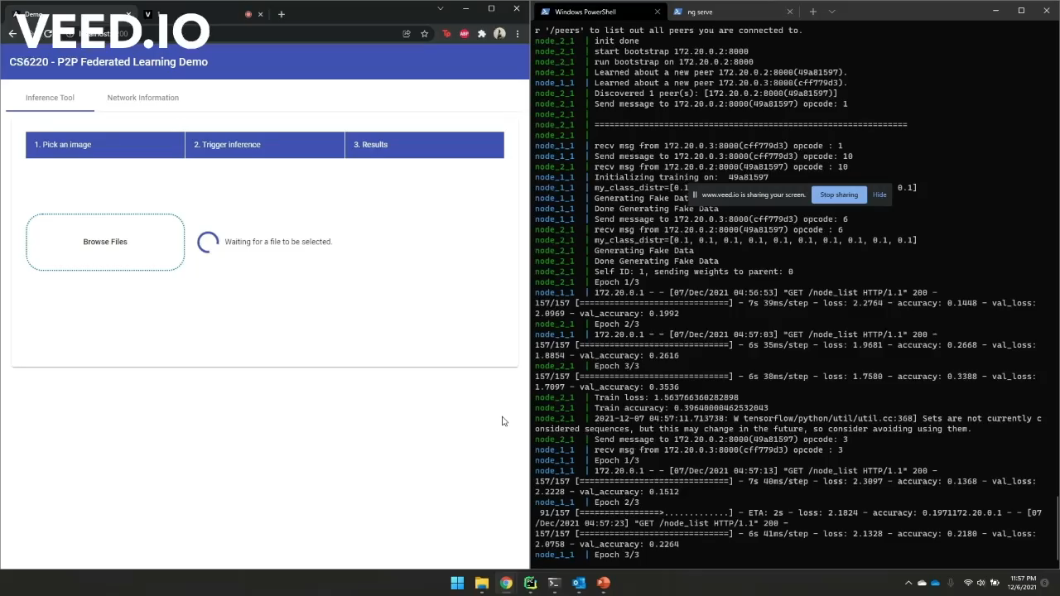
UI – Inference Example

Slide 30
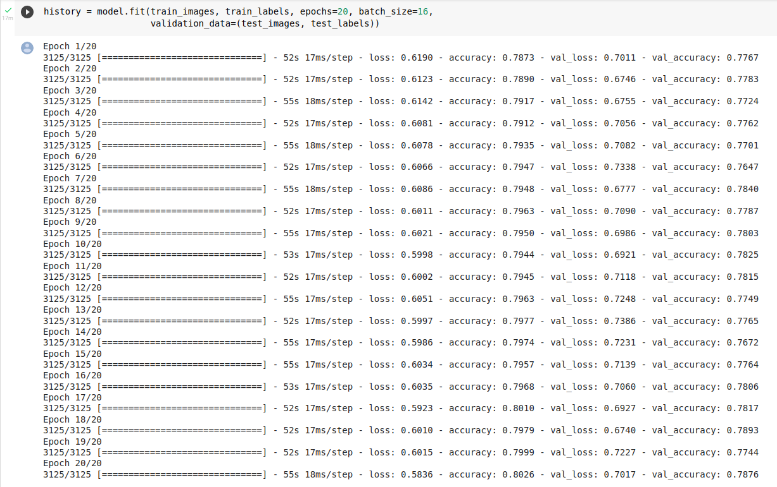
CIFAR Model
Model Accuracy on Entire Dataset = ~79%
(Total No. Of Epochs = 40)

Slide 31
Experiments

Slide 32
Assumptions
For all our experiments, we set a common number of classes across all nodes and maintain uniform distribution. Example: Every node will work on exactly N classes (albeit randomly chosen) at a time.
We fix the size of dataset and partition dataset equally depending on the number of classes. For example: A dataset of size 10000 with N = 5 will split use 2000 instances of 5 classes chosen at random.
We expect no loss of messages currently for our state machine to progress.
Training accuracy is for classes chosen for peer. However, validation accuracy is measured against instances of all classes, across all experiments.
We’re not aiming for the highest accuracy possible per node since we’re limiting by the number of epochs.
We start from a completely untrained model, as opposed to pre-trained models.

Slide 33
Comparison Metrics and Parameters
Since we’re running in virtualized environments, using raw time as a metric is not accurate. Our measure of time is total epochs of training. We compare results across configurations after running a set number of epochs.
While training accuracy is generated per node, for our experiments, we measure performance using the validation accuracy, which is model performance validation across all classes.
Since we have multiple nodes, we’d want to consider mean validation accuracy and deviation across readings.
Configuration hyperparameters across tests:
Dataset size: To measure performance against amount of data present with clients.
Number of peers: To assess performance against amount of knowledge available in vicinity.
Classes per peer: To assess performance against knowledge of a wider availability of classes.

Slide 34
Effect of class distribution across peers
Parameters fixed: Num Peers = 6, Epochs per round = 2, Aggregation rounds = 5, Training Data Size = 5000
# Classes | Node 1 acc. | Node 2 acc. | Node 3 acc. | Node 4 acc. | Node 5 acc. | Node 6 acc. | Average acc.
4 | 30.64 | 31.96 | 28.52 | 28.52 | 26.24 | 30.28 | 29.36
6 | 44.24 | 43.32 | 45.36 | 42.24 | 44.16 | 35.88 | 42.53
8 | 48.48 | 51.72 | 50.76 | 49.60 | 45.28 | 48.64 | 49.08
10 | 59.20 | 56.60 | 59.28 | 53.12 | 57.40 | 58.96 | 57.43

Slide 35
Result Inference –Class Distribution
An increased breadth of class information amongst peers is critical for seeing better overall performance.
We see that our network sees a huge boost when all nodes have a higher number of classes they’re aware of.
This is expected since the chance of overlapping known classes with parameter value = 4 is reduced by a lot.

Slide 36
Effect of number of clients in P2P system
Parameters fixed: Num Classes = 6, Epochs per round = 2, Aggregation rounds = 5, Train Size = 20000
Number of Peers | Node-wise validation accuracies | Average acc.
6 | 0.5113, 0.4591, 0.5179, 0.4785, 0.4874, 0.4800 | 48.90
4 | 0.4581, 0.4298, 0.4722, 0.4781 | 45.95
3 | 0.4792, 0.4892, 0.4544 | 47.42
2 | 0.4860, 0.4418 | 46.39

Slide 37
Effect of data volume on clients
Parameters fixed: Num Clients = 6, Num Classes = 6, Epochs per round = 2, Aggregation rounds = 5
Data Vol. (Train Size) | Node 1 acc. | Node 2 acc. | Node 3 acc. | Node 4 acc. | Node 5 acc. | Node 6 acc. | Avg. acc. | Variance
30000 | 46.59 | 48.72 | 47.28 | 45.76 | 47.99 | 49.82 | 47.69 | 2.15
20000 | 51.13 | 45.91 | 51.79 | 47.85 | 48.74 | 48.00 | 48.9 | 4.84
10000 | 49.45 | 47.08 | 46.40 | 44.50 | 45.74 | 44.74 | 46.32 | 3.31
5000 | 44.24 | 43.32 | 45.36 | 42.24 | 44.16 | 35.88 | 42.53 | 11.7
2500 | 40.96 | 37.52 | 40.16 | 33.76 | 39.52 | 34.40 | 37.72 | 9.28

Slide 38
Result Inference – Data Volume
As expected, a higher amount of data present in the client leads to quicker convergence.
Per epoch improvement is higher due to the data quantity.
The difference in accuracies after the same no. of epochs does not increase linearly with the size of dataset.
Over time, we’ll see that the difference grows larger before it plateaus.
However, the computation required to process 30000 entities does not pay off with a higher accuracy.
There seems to be a lower amount of variance across peers when the amount of data increases.

Slide 39
Final Thoughts
From our experiments, we see that both data volume and knowledge of all classes are crucial for better results.
A higher number of peers did not seem to have a very positive effect, especially with increase in aggregation levels even though the overall chance of encountering all classes grows with the number of peers.
Aggregation techniques need to be tweaked for better results. The current technique ends up plateauing accuracy after a few weight sharing rounds.

Slide 40
Future Work
Support for different, weighted averaging schemes.
Use alternate distributed tree creation algorithms to optimize for network bandwidth (E/R trees)
Improve fault tolerance on a sub round level
Implementation on Edge/Mobile Devices – requires reduction of memory usage.
Incorporating Heterogenous Devices for Dynamic Partitioning
Compute Power
Geospatial Locality
Network instability and latency
Using a higher resolution dataset with more classes Example – Face Detection on VGGface2 Dataset
Benchmark on multinomial classification dataset such as celebA

Slide 41
THANK YOU!

Slide 42

QUESTIONS

